Slide 1
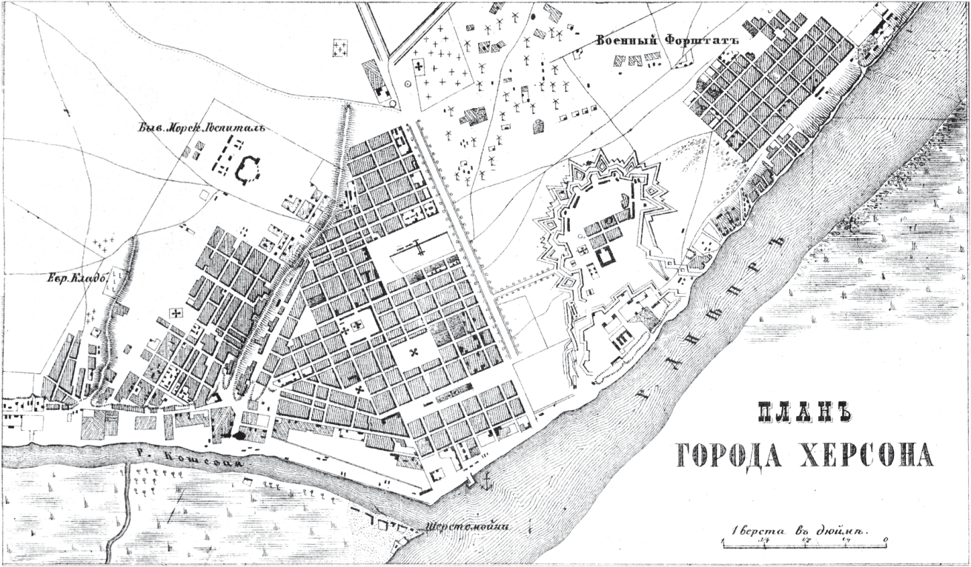

Slide 2
Empress Catherine II
Grand Duke Paul
Lt. General Khorvat
Grand Duke Nikolai Pavlovich
Prince Platon Zubov
Onufrii Volkov
French spies
Lt. Colonel Iakovlev
a Jewish merchant
Major General Obolenskii
the carpenter-ringleaders
Vice Admiral Mordvinov
strangers from Nikolaev
Police captain Pogorelov
purveyors of watermelon
Rear Admiral Pustoshkin
Ensign Kostychev
Lt. General Femers
Iogan Shul’ting
Rear Admiral Golenkin

